Slide 1
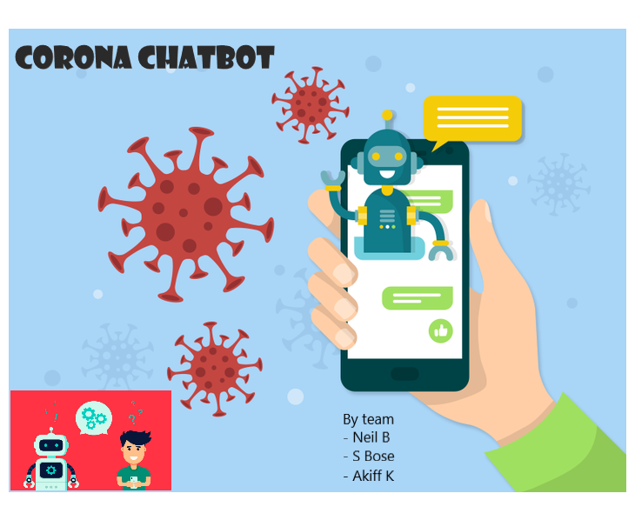

Section : K19KK
Group : 7
Reg. no: Roll no:
11902386 (07)
11904644 (17)
11918665 (68)

Slide 2
Content
Link of the loom videos
Technologies used in this project
Practical use cases
Type of questions that can be asked
0 level DFD
Designation of responsibilities
Slide 3
Slide 4-7
Slide 8
Slide 9
Slide10
Slide 11

Slide 3
Links of the video presentation of our application : Corona Chatbot (Python Project)
We have used loom website for the making of our video presentation
Kindly follow the flow of the presentation stated below.
Bose (1st) loom link { video presentation } copy it and past in the search bar
Link : https://www.loom.com/share/08cdeb6ff1c940d0ac54b026dd9a085f
Neil (2nd)
Link : https://www.loom.com/share/9f4546f3210349378fdb59bf753f9531
Akiff (3rd)
Link: https://www.loom.com/share/0d5ab212c30c4ff5b537fc6f698f2976
Kindly proceed with the rest of the PowerPoint Presentation.

Slide 4
Technologies used in this project
Modules imported:
NLTK;
Tensorflow;
Keras;
Numpy;
Tkinter;
Languages used:
Python (For interface and backend);
Json (For training data);
Json is a non-relational database hence no ER diagram has been created.

Slide 5
Technologies used in this project
NLTK
NLTK (Natural Language Toolkit) is a leading platform for building Python programs to work with human language data. It provides easy-to-use interfaces such as WordNet, along with a suite of text processing libraries for classification, tokenization, stemming, tagging, parsing, and semantic reasoning, wrappers for industrial-strength NLP libraries, and an active discussion forum.
Tensorflow
TensorFlow is an end-to-end open source platform for machine learning. It has a comprehensive, flexible ecosystem of tools, libraries and community resources that lets researchers push the state-of-the-art in ML and developers easily build and deploy ML powered applications.

Slide 6
Technologies used in this project
Keras
Keras is an API designed for human beings, not machines. Keras follows best practices for reducing cognitive load: it offers consistent & simple APIs, it minimizes the number of user actions required for common use cases, and it provides clear & actionable error messages. It also has extensive documentation and developer guides.
Numpy
NumPy is a python library used for working with arrays. It also has functions for working in domain of linear algebra, Fourier transform, and matrices. NumPy was created in 2005 by Travis Oliphant. It is an open source project and you can use it freely. NumPy stands for Numerical Python.

Slide 7
Technologies used in this project
Tkinter
Tkinter is Python's de-facto standard GUI (Graphical User Interface) package. The tkinter package (“Tk interface”) is the standard Python interface to the Tk GUI toolkit. Both Tk and tkinter are available on most Unix platforms, as well as on Windows systems. (Tk itself is not part of Python; it is maintained at Active State.)

Slide 8
Practical Use Cases
This project can help a lot of people to alleviate the anxiety caused by the current unprecedented pandemic.
This intelligent chatbot has an advice for most of your COVID related dilemma.
This simple user-interface enables people form all ages and walks of life

Slide 9
What kind of questions can be asked…
Hello
See you later
who can be sick?
Which medicine can treat COVID-19?
What to do if I have COVID-19?
What are the symptoms?
How to be safe?

Slide 10
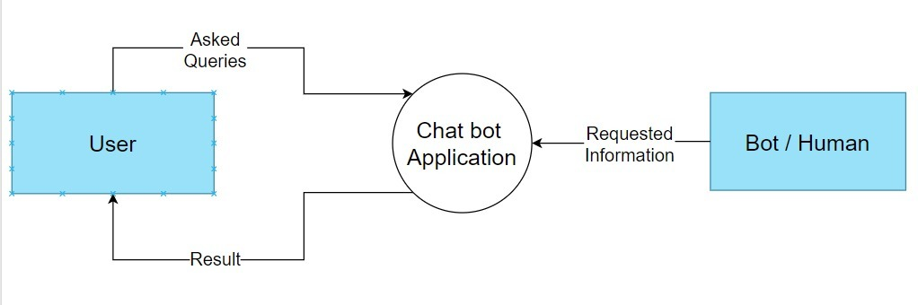
0 level Dataflow Diagram (DFD)

Slide 11
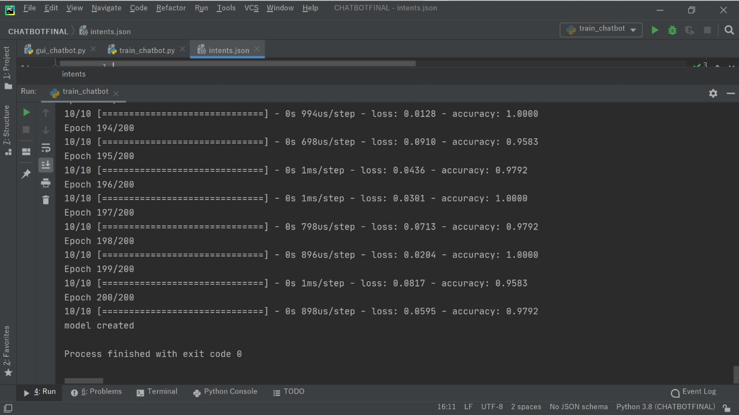
Data being trained

Slide 12
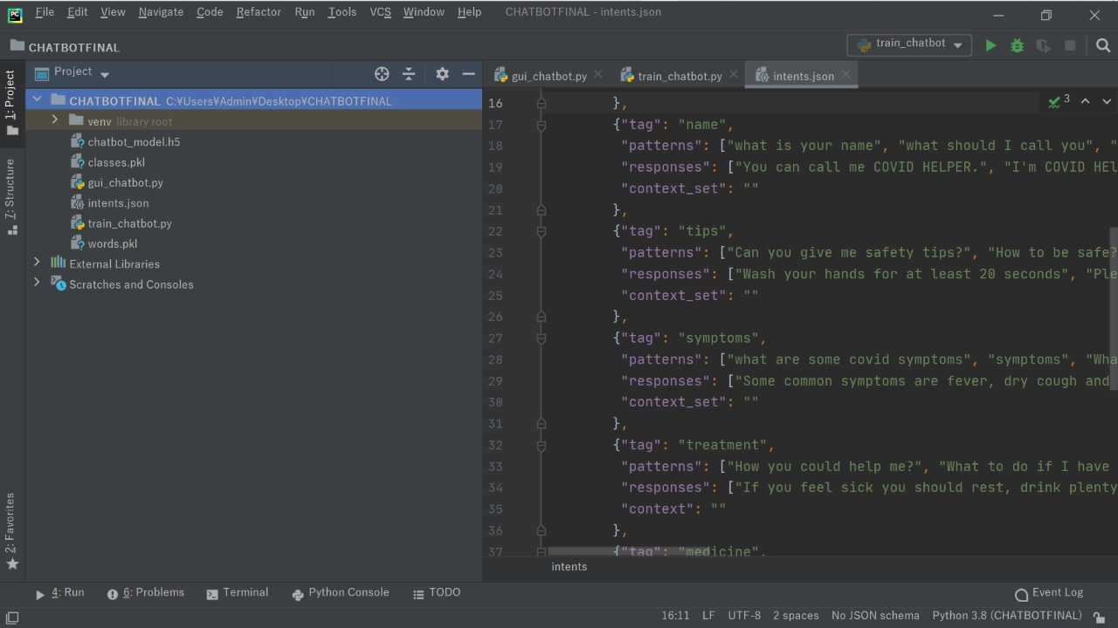
Source files

Slide 13
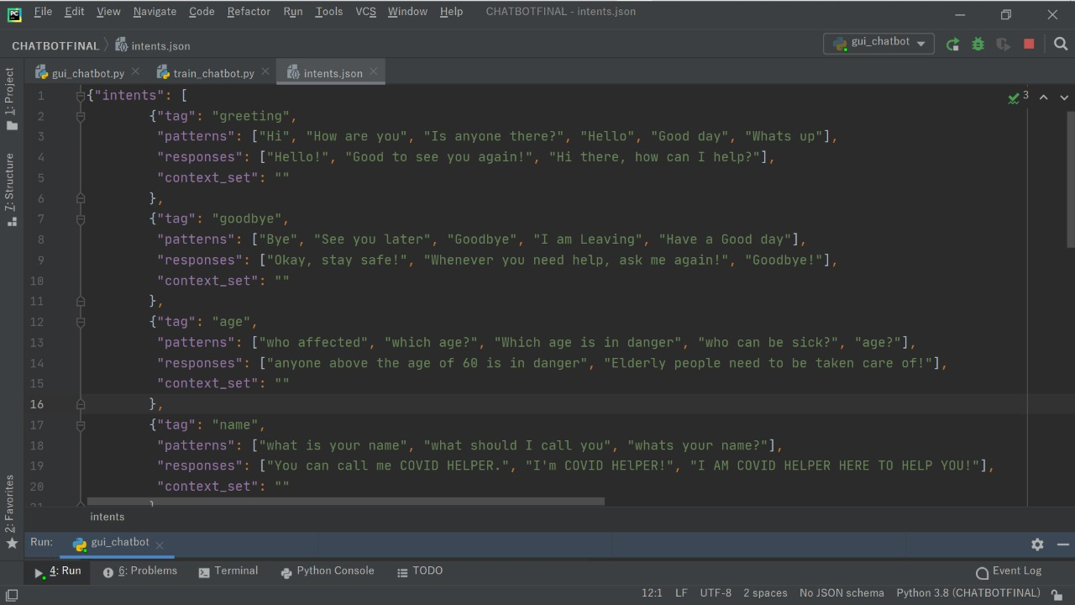
Json code

Slide 14
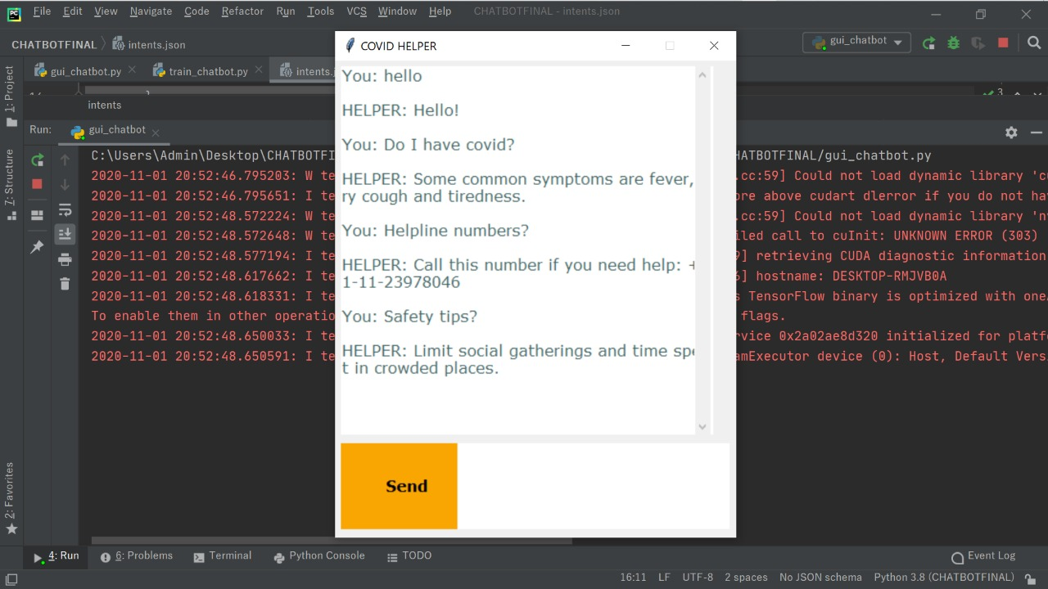
Final Output

Slide 15
Designation of responsibilities
Neil
Data collection and Backend
Souhardya Bose
User Interface and Backend
Akiff Khoja
Data collection and Documentation

